Slide 1


Optimizing enzyme combinations for shotgun proteomics
Sabrina Khuntia
Gao Lab (College of Pharmacy)

Slide 2

Outline
Research question
Physicochemical property comparisons
Enzymatic cleavage simulation (using AlphaFold predicted collagen protein structures)
Developing a structural kinetic mathematical model

Slide 3
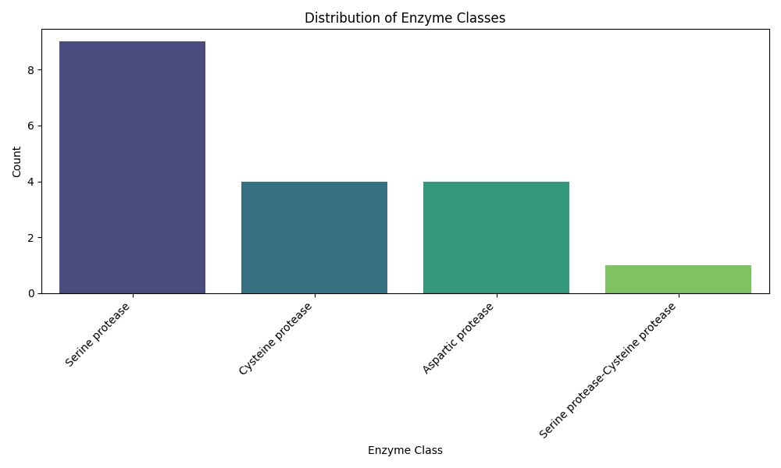
Introduction
Limitations of average proteomic experiments
Ex: coverage of human proteome = 99% with 6 enzymes vs. 86% with trypsin alone
Emphasis on mass spectrometry proteases

Slide 4
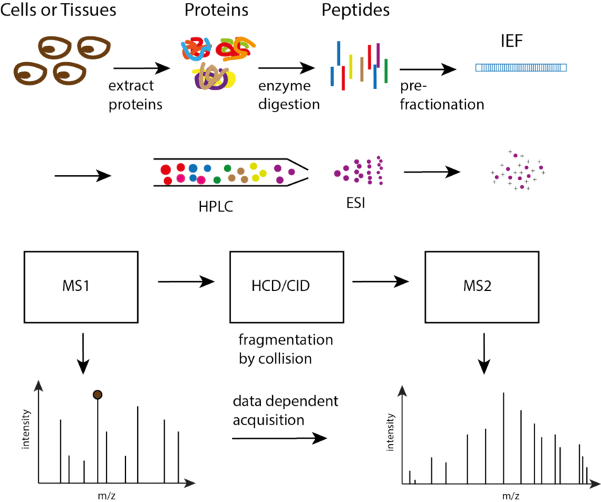
Optimization focus

Slide 5
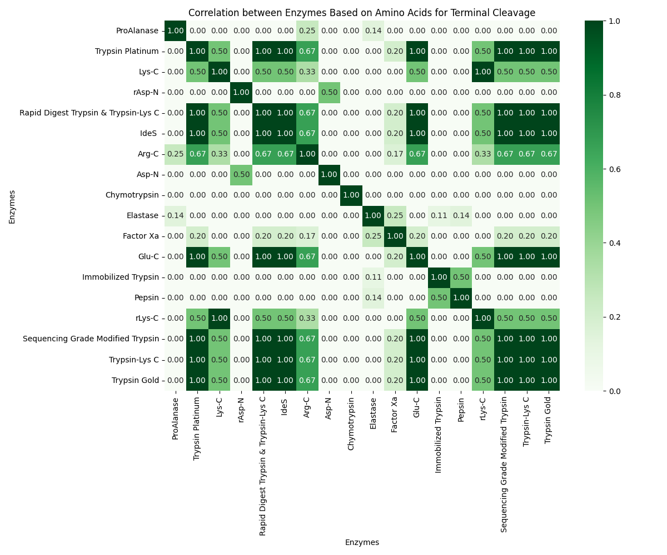
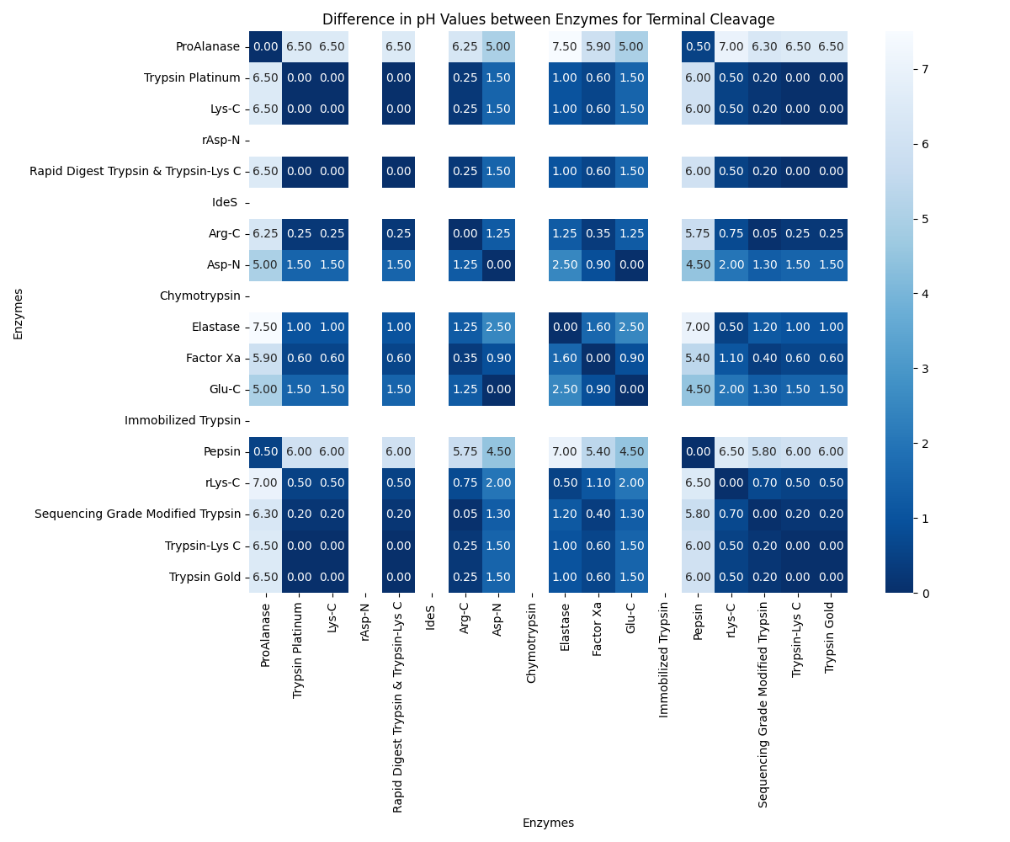
Protease Cleavage Site + pH Difference Specificity Maps

Slide 6
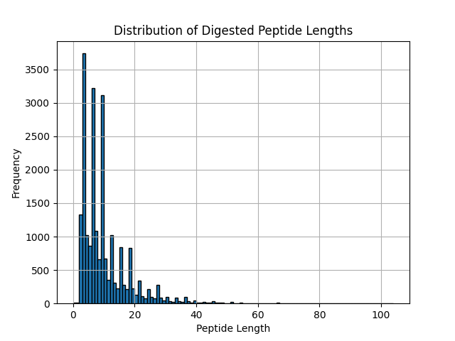
Simulation results with trypsin
Number of peptides that satisfy the mass spectrometer's detectability conditions: 11372
Theoretical average detected sequence coverage by trypsin: 42.32%
Average size of digested peptides: 9.734062668827661
Maximum size of undigested peptides: 104

Slide 7
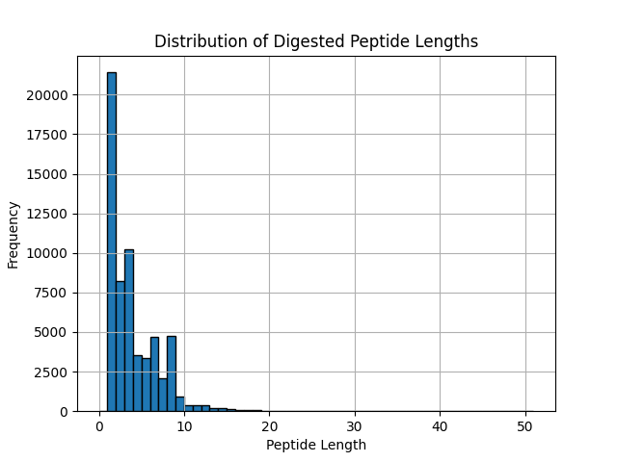
Simulation results with chymotrypsin
Number of peptides that satisfy the mass spectrometer's detectability conditions: 9787
Theoretical average detected sequence coverage by chymotrypsin: 38.42%
Average size of digested peptides: 3.52816487712542
Maximum size of undigested peptides: 51

Slide 8
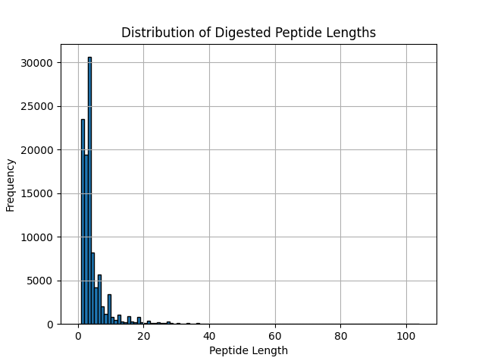
Simulation results with trypsin + chymotrypsin (sequential)
Number of peptides that satisfy the mass spectrometer's detectability conditions: 13300
Theoretical average detected sequence coverage by trypsin and chymotrypsin: 49.56824982771619%
Average size of digested peptides: 4.094245299096745
Maximum size of undigested peptides: 104

Slide 9
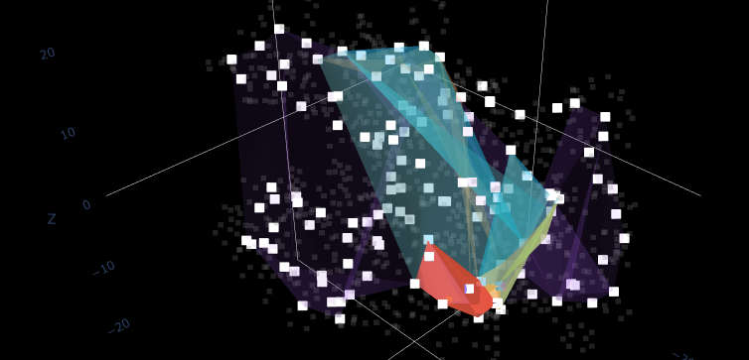
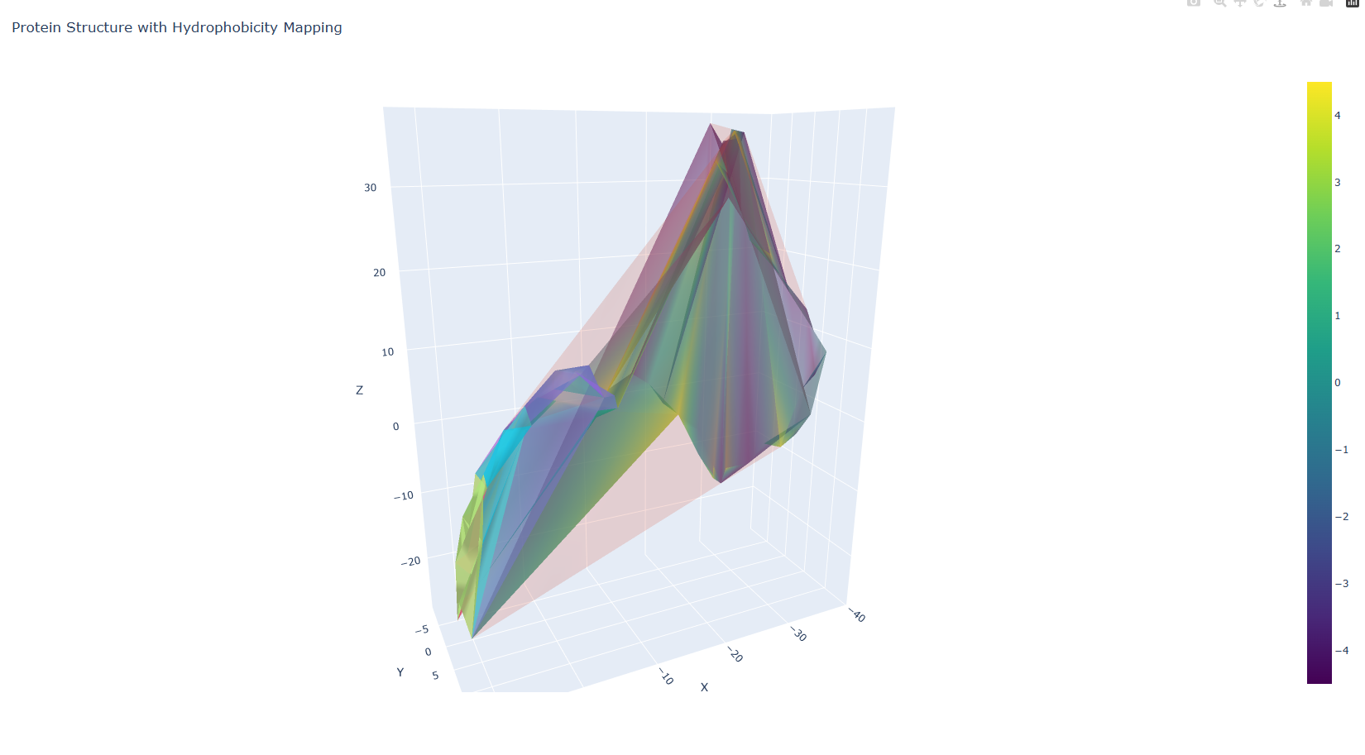
Parameter: Detected Hull Layers
Convex hull peeling method
Imposes layers on backbone atomic coordinates
Allows for a better idea of directional affinity relative to the centroid
Gauges when the substrate breaks apart

Slide 10
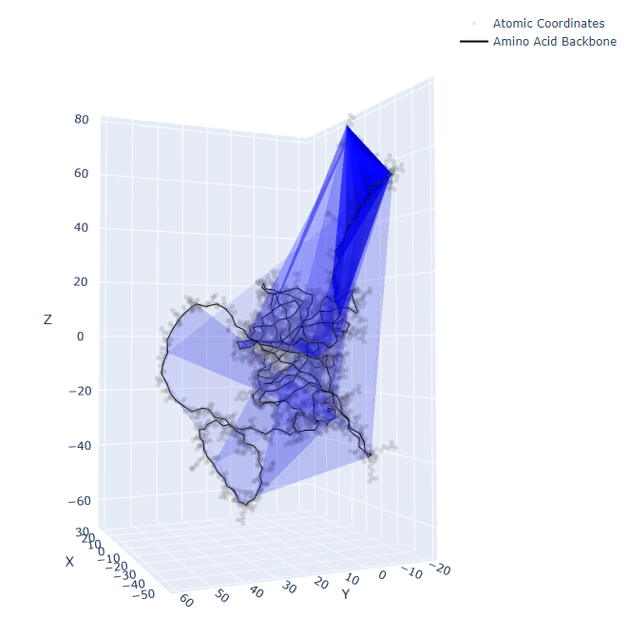
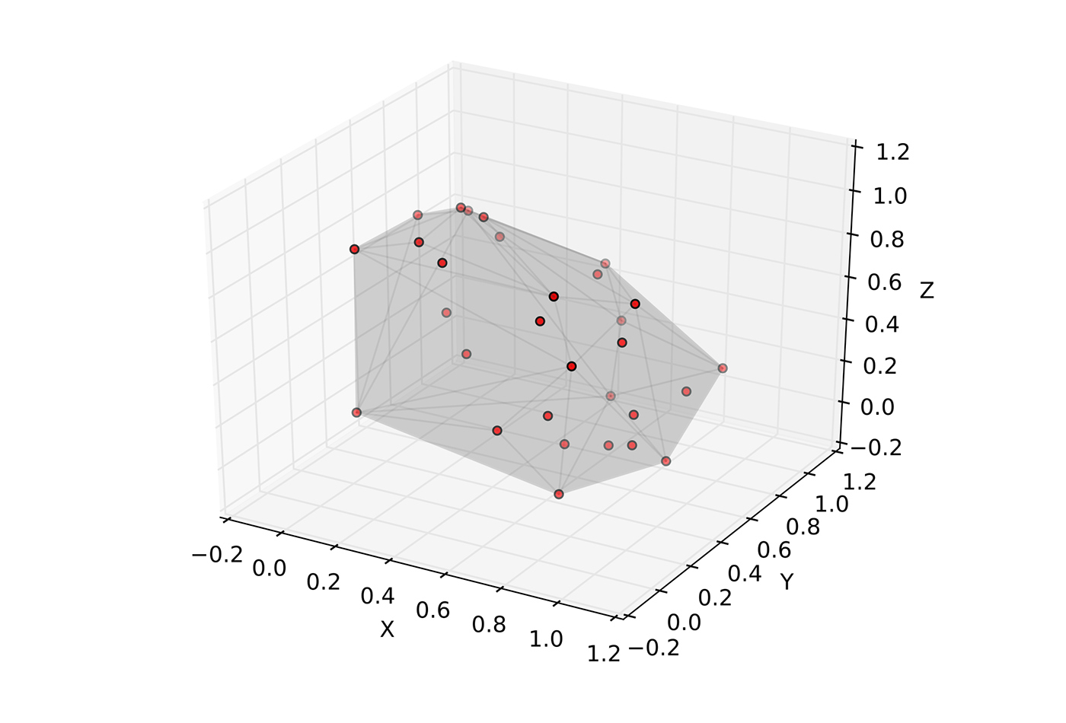
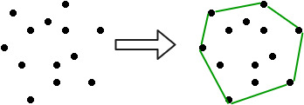
Structurizing molecular models with convex hulls
3D (PROTEIN)
3D (GENERAL)
convex hull = smallest convex shape that contains the given set of points
1) Find a three-dimensional convex hull by determining the following:
The largest polyhedron whose vertices are points in B.
The set of all convex combinations of points in B.
The intersection of all convex regions in B.
The union of all simplices with vertices in B.
To continue layering, ideally until the minimum hull size is reached (for biomolecules, set this value as the length of the smallest building block in the structure):
2) “Delete” vertices (for calculation purposes only – this step accounts for the extreme observations – but keep values for plots).
3) Repeat steps 1-3 (in other words, keep finding a new hull based on the previous hull).
2D

Slide 11
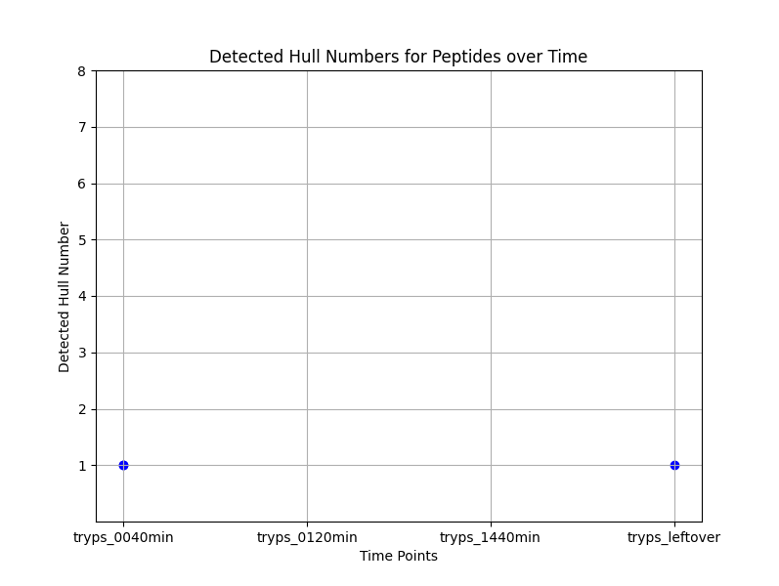
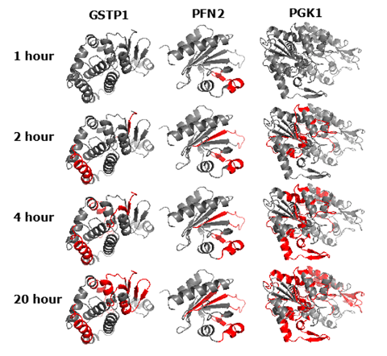
A combined approach to determine the kinetics of enzymatic cleavage
Limited Proteolysis
Discrete Geometry

Slide 12

Thank you!

